Slide 1
GOVERNMENT OF ANDHRA PRADESH GROUND WATER AND WATER AUDIT DEPARTMENT
1st WORLD BANK MISSION UNDER NATIONAL HYDROLOGY PROJECT
IMPLEMENTAION OF NATIONAL HYDROLOGY PROJECT
17TH & 18TH AUGUST, 2017 BENGALURU | DIRECTOR GROUNDWATER & WATER AUDIT DEPARTMENT, VIJAYAWADA, ANDHRA PRADESH

Slide 2
DETAILS OF STATE PROJECT MONITORING UNIT (APGW)
 | Name and Designation | Role in PMU
1 | Sri. Sashibushan Kumar, Secretary, WRD | Project Co-Ordinator
2 | Sri. K. Venugopal, Director, GW&WA Dept. | Nodal Officer
3 | Sri. T. Govardhan, Deputy Director | Senior Water Management Expert
4 | Sri. N. Srinivasu, Deputy Director | Superintending Officer
5 | Sri. K. Padma Prasad, Assistant Director | Procurement Officer and GIS Expert
6 | Sri. H. M. Raghuram, Assistant Geophysicist | Database Management Expert
7 | Sri. E. Sunil Kumar, Assistant Hydrogeologist | GIS Expert
8 | Sri. S. Anjaneyulu, Assistant Hydrogeologist | GIS Expert
9 | Smt. Vijaya Druga, Assistant Hydrologist | Modeler
10 | Sri. Ram Balaji Reddy, Assistant Hydrologist | Modeler
11 | Sri. A. Pattabhi Reddy, Dy. Executive Engineer | MIS Expert
12 | Sri. K. Panakala Rao, Dy. Executive Engineer | MIS Expert
13 | Sri. A. V. Raja Rao, Assistant Accounts Officer | Accounts Officer
As per G.O.Ms.No.91, dated 24.08.2016 of Secretary to Government, WRD, Govt. of Andhra Pradesh

Slide 3
Funds received and expenditure incurred (2016-17 & 2017-18)
Funds received for the year 2016-17 : Rs. 221.90 Lakhs
Interest accrued till June 2017 : Rs. 3.48 Lakhs
Total : Rs. 224.90 Lakhs
Expenditure incurred so far (till date) : Rs. 90.94 Lakhs
Expenditure Committed : Rs. 19.93 Lakhs
Total expenditure : Rs. 110.87 Lakhs
% of expenditure : 50%
Funds allotted for the year 2017-18 : Rs. 381.00 Lakhs
(1st tranche, yet to receive)

Slide 4
Major Procurement Items in PIP
Procurement of IT Infrastructure : Rs. 700.00 Lakhs
Construction of 1 State and 2 District Data Centers : Rs. 1500.00 Lakhs
DWLRs with Telemetry (350 Nos) : Rs. 350.00 Lakhs
Drilling of Piezometers (350 Nos) : Rs. 262.50 Lakhs
Drilling of nested piezometer wells in sedimentaries : Rs. 100.00 Lakhs
Drilling of shallow/medium wells in coastal areas
for saline ingression studies : Rs. 75.00 Lakhs
Realtime WQ DWLRs with telemetry : Rs. 225.00 Lakhs
Water quality field equipment for district units : Rs. 128.00 Lakhs
(Sonde)
water quality equipment for WQ labs : Rs. 375.00 Lakhs

Slide 5
Major Procurement Items in PIP continued
GP equipment for field surveys : Rs. 105.00 Lakhs
Bore hole logging equipment : Rs. 75.00 Lakhs
WQ field equipment, WQ Kit1, WQ Kit2 : Rs. 58.00 Lakhs
Furnishing State and District Offices with : Rs. 73.50 Lakhs
Non ITC equipment
Software for State Data Center : Rs. 200.00 Lakhs
Conducting well performance test in each GEC Basin : Rs. 883.20 Lakhs
(736 GEC Basins)
DSS for urban hydrology for Visakhapatnam : Rs. 75.00 Lakhs
Geo-referencing all monitoring wells : Rs. 60.00 Lakhs
(4000 Monitoring Wells)

Slide 6
Major Procurement Items in PIP continued
Study of behavior of multi-aquifer system of kunderu basin : Rs. 60.00 Lakhs
for sustainable GW development in East and West Godavari and
Krishna district
Pilot study for Impacts of Sand mining on groundwater regime : Rs. 61.80 Lakhs
Study on climate change and desertification of Pennar basin in
Anantapur, Chittoor and Kadapa districts : Rs. 65.80 Lakhs
International Trainings/National trainings including dedicated
training on GIS & other software, in house trainings etc., : Rs. 200.00 Lakhs
Workshops on groundwater and International Study Tours : Rs. 100.00 Lakhs
Outsourcing of incremental staff : Rs. 700.00 Lakhs
Recurrent cost of operation of SPMU including hiring of vehicles : Rs. 400.00 Lakhs
Establishment and operational cost of PMU : Rs. 200.00 Lakhs

Slide 7
Major Procurement Items in 2016-17
Procurement of AC's for SDC and DDC : Rs. 6.00 Lakhs (Rs.6.24 Lakhs)
(Procurement completed under Shopping)
Ground Water Monitoring Equipment : Rs. 30.00 Lakhs (Rs.23.67 Lakhs)
(Procurement completed under Shopping)
Procurement of hand held GPS : Rs. 30.00 Lakhs (Rs.29.25 Lakhs)
(Procurement completed under Shopping)
Procurement of differential GPS : Rs. 30.00 Lakhs (Rs.29.71 Lakhs)
(Procurement completed under Shopping)
Procurement of Geo-Physical Survey Equipment : Rs. 65.00 Lakhs
(procurement to be completed by this month end)

Slide 8
Major Procurement Items in 2017-18
Procurement of IT Hardware and Software : Rs. 100.00 lakhs
(Rs.350.00 lakhs proposed but only 100 lakhs approved in AWP)
Construction of State Data Centre : Rs. 150.00 Lakhs
Procurement of equipment for WQ labs located at
Visakhapatnam, Rajahmundry, Kadapa and Kurnool : Rs. 40.00 Lakhs
Furnishing of SDC and DDC : Rs. 17.50 Lakhs
Drilling of Piezometers for study of saline ingression : Rs. 71.25 Lakhs
Procurement of AC's for SDC and DDC : Rs. 7.50 Lakhs
Design of State data center for SW and GW in Vijayawada : Rs. 25.00 Lakhs
Upgrading existing Website and Maintenance : Rs. 10.00 Lakhs
Training for field officers in GW Estimation, HIS etc. : Rs. 10.00 Lakhs

Slide 9
Major Procurement Items in 2017-18
Procurement of geological survey kits : Rs. 25.00 lakhs
Procurement of Survey of India geo-referenced toposheets
for entire Andhra Pradesh : Rs. 15.00 Lakhs
O&M of existing systems at SDC & 16 DDC : Rs. 15.00 Lakhs
Out Sourcing of Incremental Staff Cost : Rs. 163.00 Lakhs
Consultancy services for 1 DSS and 2 PDS Studies : Rs. 20.00 Lakhs
Establishment and Operational Cost of SPMU & PMU : Rs. 10.00 Lakhs
Digitization of old reports and printing of Year Books : Rs. 6.00 Lakhs
Procurement of Software of SDC (MS Office, Adobe pdf) : Rs. 2.50 Lakhs
Hiring of Vehicles : Rs. 36.00 Lakhs

Slide 10
Physical Progress
AWP 2016-17
Completed
Procurement of 14 Nos. Air Conditioners for SDC & DDCs (Expenditure: Rs.6.24 Lakhs)
Procurement of Water level monitoring equipment (Expenditure: Rs.23.67 Lakhs)
Procurement of Handheld GPS (Expenditure: Rs.29.25 Lakhs)
Procurement of DGPS (Expenditure: Rs.29.71 Lakhs)
Process under way
Procurement of Geo-Physical survey equipment (Estimated Cost Rs.65.00 Lakhs)
AWP 2017-18
Received approval of AWP 2017-18 recently, funds allotted, yet to be released, procurement will start during September 2017

Slide 11
Status of Bid Documents
Floated
Bid documents for floating, will be done in September 2017
Ready to be floated
Bid document for procurement of Geo-Physical Survey Equipment is ready for floating under National Shopping Procedure (RS.65.00 Lakhs, AWP 2016-17)
For AWP 2017-18, Bid documents for Procurement of AC's for SDC and DDCs (Rs.7.50 Lakhs), Procurement of Software like MS Office, Adobe pdf for SDC (Rs.2.5 Lakhs), Procurement of Water Quality Equipment for WQ Labs (Rs.40.00 Lakhs), O&M of existing systems at DDC and SDCs (Rs.15.00 Lakhs), Furnishing of DDC and SDC (Rs.17.50 Lakhs) all under National Shopping Procedures are ready to be floated.
Under preparation
Procurement of Survey of India Geo referenced topo sheets (RS.15.00 lakhs) under single source.
Procurement of IT Hardware & software under NCB goods (Rs. 100.00 Lakhs
Drilling of 350 Nos Piezometers under NCB Works (Rs.350.00 Lakhs)
Drilling of Piezometers for study of Saline ingression in coastal aquifers under NCB Goods (Rs.71.25 lakhs)

Slide 12
Status of various studies/PDS
DSS Studies
APGW has proposed study of Urban Hydrology for the fast growing Industrial city of Visakhapatnam in collaboration with NIH, Kakinada and Andhra University , Visakhapatnam with a budget of RS.65.00 lakhs and has allocated Rs.5.00 lakhs.
PDS Studies (three studies)
APGW has proposed three PDS Studies
Study of behavior of multi-aquifer system of kunderu basin for sustainable groundwater development in East and West Godavari and Krishna district in collaboration with NIH, Kakinada, with a budget of Rs.65.00 lakhs.
Study on climate change and desertification of Pennar basin in Anantapur, Chittoor and Kadapa districts in collaboration with NIH, Belgaum and with a budget of Rs.65.00 lakhs.
Pilot study for Impacts of Sand mining on groundwater regime in collaboration with NIH, Belgaum
Status of PDS
Proposals for Study of multi-aquifer system in Sedimentary formations of Godavari and Krishna Basins and Study on climate change and desertification of Pennar basin in Anantapur, Kadapa and Chittoor districts have been submitted to NIH, Roorkee. NIH, Roorkee has sent the proposals for modification. These are being attended and will be re-submitted by this month end.

Slide 13
Status of Hydromet Stations - Groundwater
Summary of Ground Water Network for Monitoring
Monitoring Well Network Summery |  |  |  |  |  |  | Measurement Mode
Aquifer | No.of Exisiting Monotoring Stations | T ype of Monotorin g Stations (DW/PZ) | Proposed No.of Monitorin g Stations in NHP (DW) | Proposed No. of Monitorin g Stations in NHP PZ | Total number of monitori ng station (Exisiting Proposed in NHP) | Number of stations (for WL monitorin g only) | Nnmber of stations (for WL and WQ monitorin g) | Manual | DWLR (Exisitin g) | DWLR with Telemerty (Exisiting) | DWLR with Telemerty (Proposed)
Shallow (phreatic 1< 50 mbgl) | 833 CGWB -61 APGW - 772 | pz | 0 | (140- PIP) 300 | 1133 | 0 | 833 | 292 |  | 1259 | 1161 (292+869)
Deep (confined/ semi- confined > 51 mbgl) | 718 CGWB-42 APGW-676 | pz | 0 | (350- PIP) 569 | 1287 | 0 | 718
 | 1551 |  |  | (490) 869 | 2420

Slide 14
Status of Public Finance Management System
APGW will be registering for PFMS and will populate the data by this month end

Slide 15
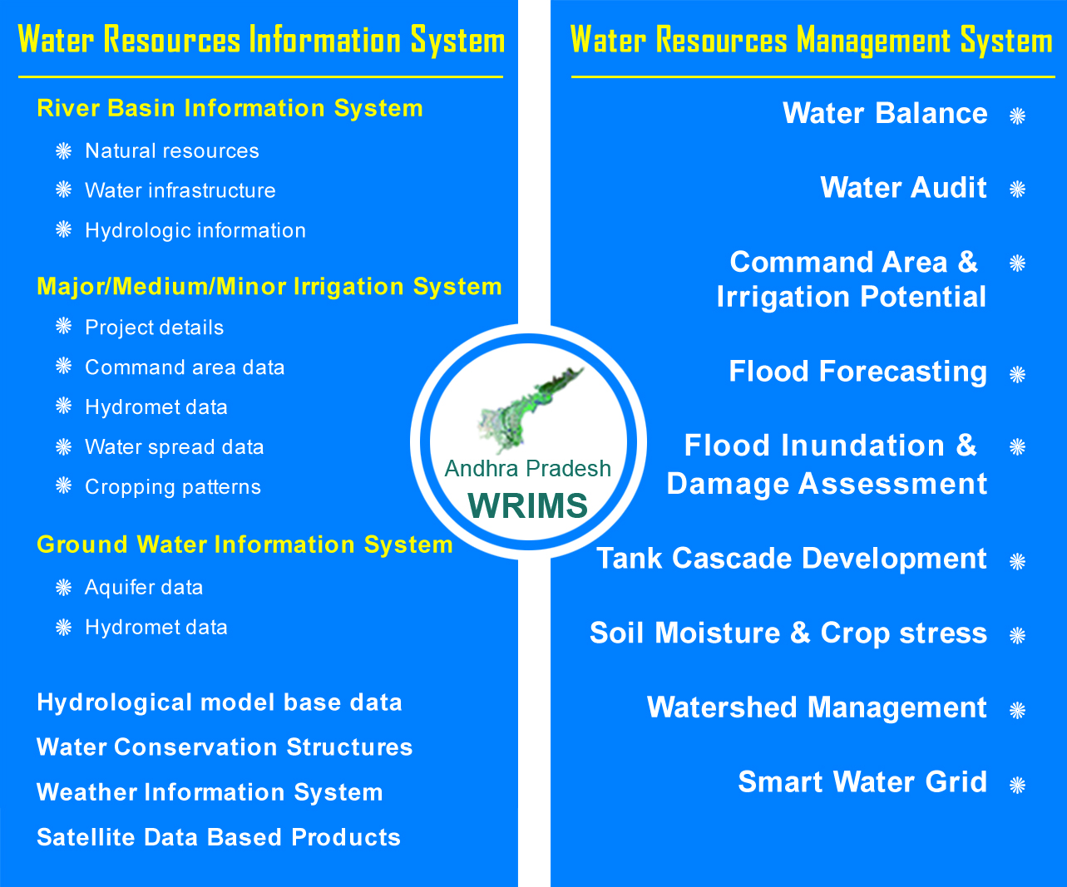
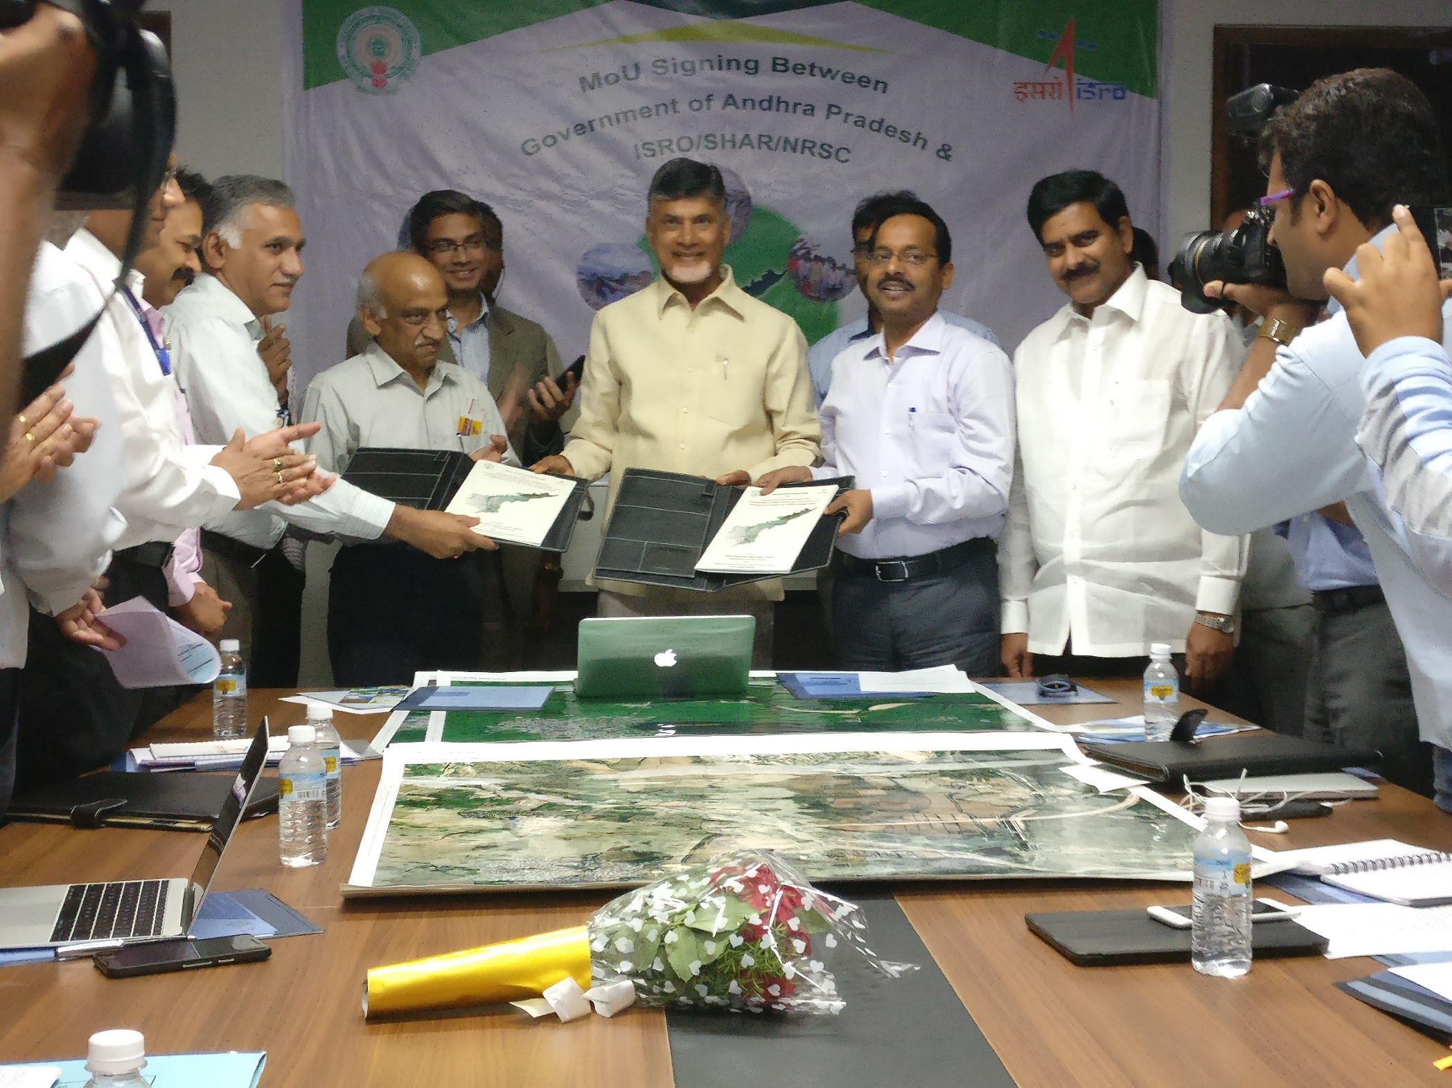
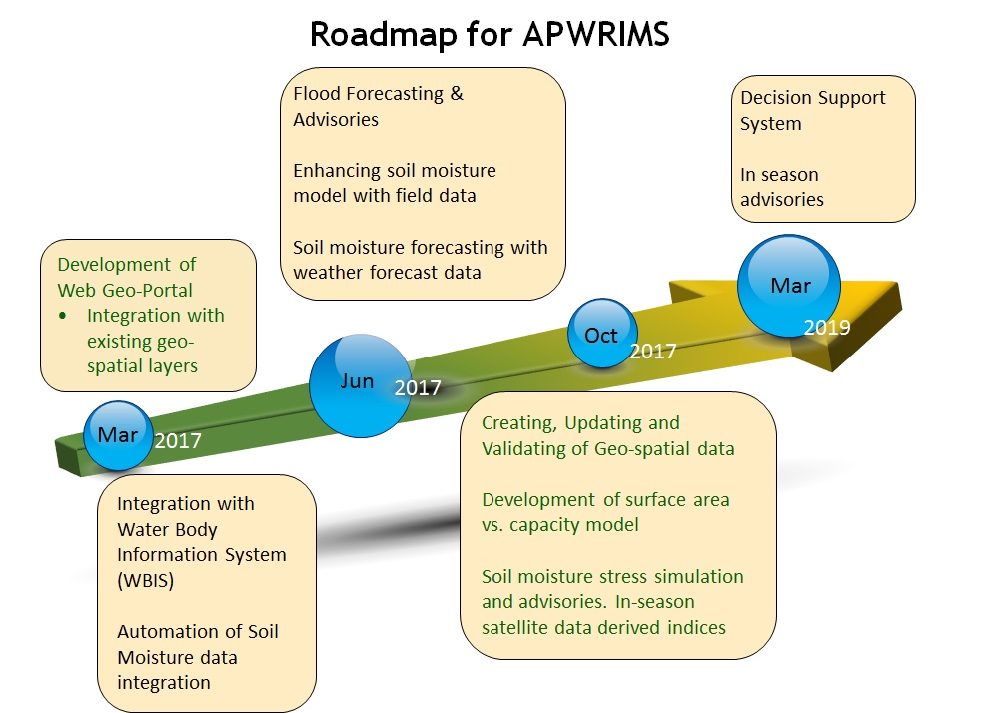
Status of State WRIS
A Collaborative Project with NRSC
APWRIMS

Slide 16
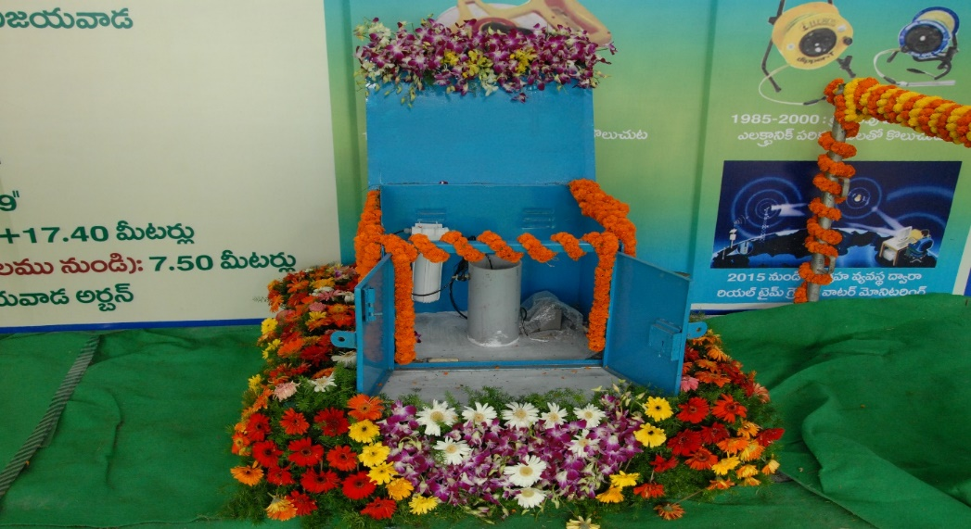
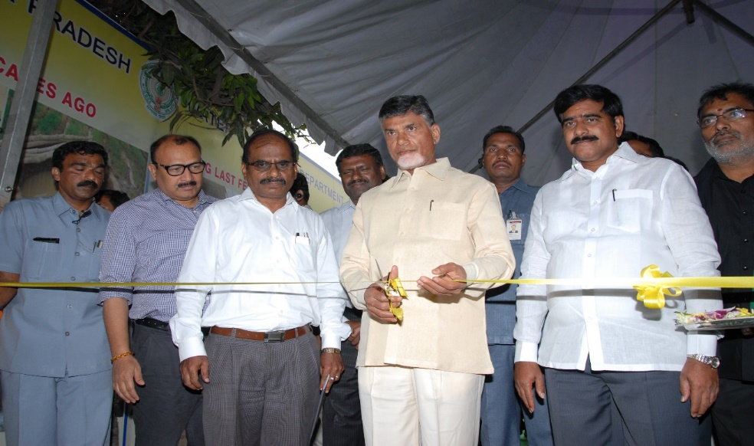
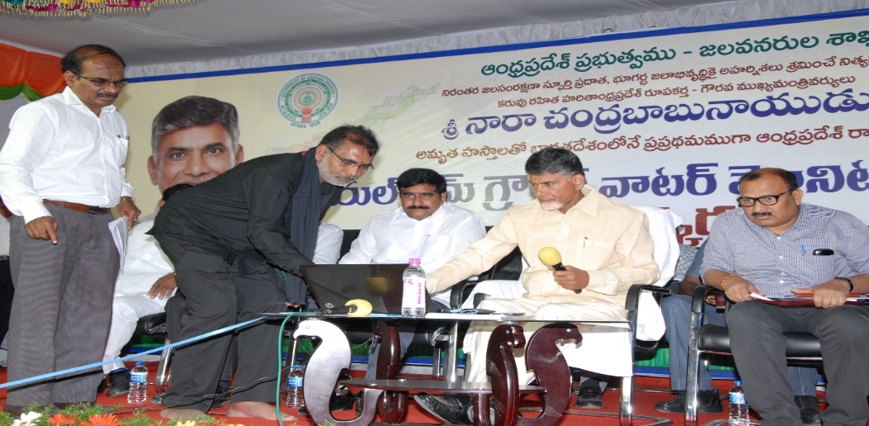
REAL TIME GROUNDWATER MONITORING IN ANDHRA PRADESH
PIEZOMETER MONITORING NETWORK
INAUGURATION OF REAL TIME GW MONITORING SYSTEM By Hon’ble Chief Minister of Andhra Pradesh
Sri N.CHANDRA BABU NAIDU

Slide 18
Thank you

